Slide 1
Computer Science presentations
Spring 2020

Slide 2



Where we are going
What works
What often needs attention
How to address the needs

Slide 3

Houston we have lift-off
Content
Data
Project Information
Powerpoint
Knowledge-Transfer
Time

Slide 4
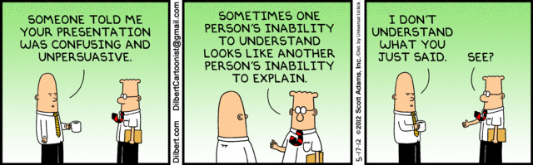
Houston we may have a problem…
Introductions
Technical Jargon
Own your space
Voice Inflection
Organization
Practice

Slide 5

Why does it matter…
Honest and fair question
We all have something to ”sell”
The goal of every presentation is for all to share in understanding
The goal of every presentation should be to relate with your audience

Slide 6
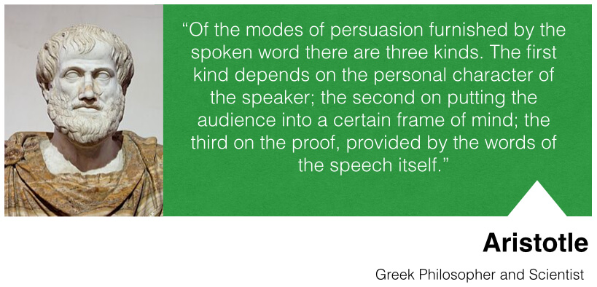

Aristotle – Modes of proof
ETHOS
PATHOS
LOGOS

Slide 7

Credibility - few start with it. Most have to build it
Primary
Expertise
Trustworthiness
Goodwill
Secondary
Dynamism
Composure
Sociability
This Photo by Unknown Author is licensed under CC BY-SA-NC

Slide 8

Credibility as a multi-dimensional element
Well prepared and organized
Know your information
Include background & expertise
Establish trust
Be likeable
Authentic good will

Slide 9
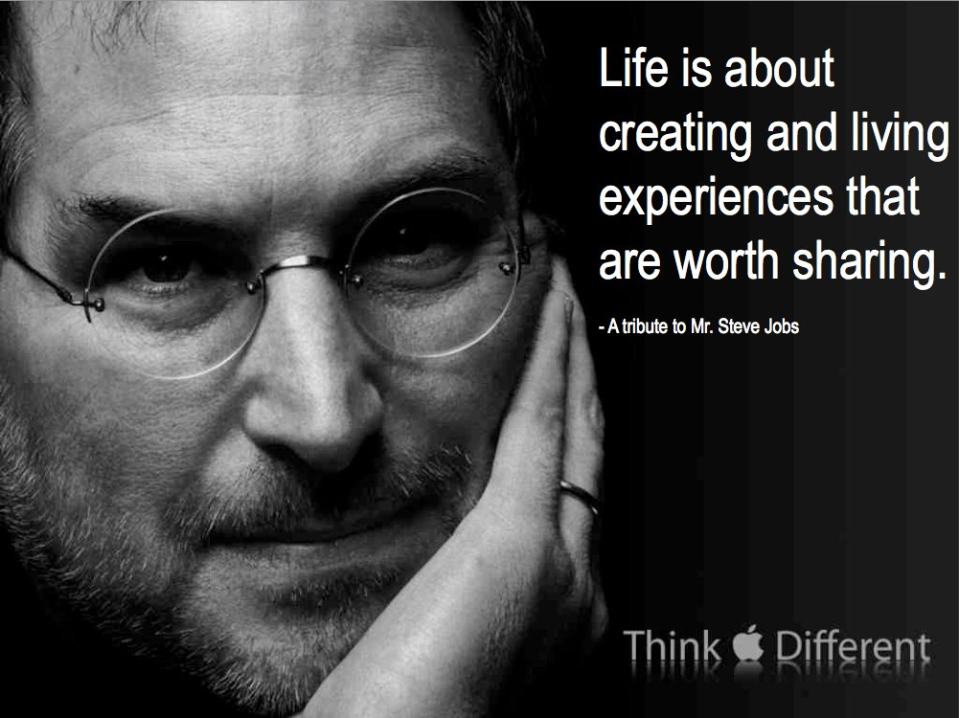
PATHOS – (Emotion)
Dynamism
Composure
Sociability
This Photo by Unknown Author is licensed under CC BY

Slide 10

the reality of a presentation

Slide 11
Presentation fundamentals
Content
Relationship
Structure
Presentation Effectiveness
Introduction
Name Presenters
Attention Getter
Relationship Bridge
What is your goal?
Content (Body)
Know your content
Know your plan
Conclusion
Notes:
Squeezing too much content into a presentation make it hard to be effective

Slide 12
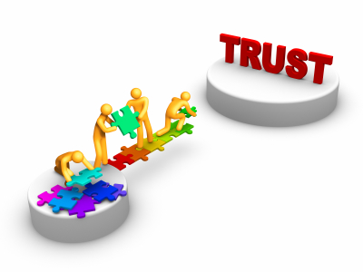
Relating Through a speech
Non-Relational
Relational Communication
Material only
Data only
Agenda Driven
Tunnel Vision
Material shared in relation to the audience
Data given to show impact
Flexible presentation focused on audience understanding
Adapting to audience cues
This Photo by Unknown Author is licensed under CC BY-NC-ND

Slide 13
Practical tips on How to make a presentation relational?
Non-Verbal (Own your space)
Verbal (Command Attention)
Eye contact – Remember the sprinkler
Proximity – Step toward the audience
Movement
Appropriate use of gestures
Clothing – Yes, even clothing speaks
Avoid using a passive stance
Word Choice
Interactive
Audience driven
Reinforced learning
Voice Inflection
Avoid powerless communication
Notes:
Be jealous of the attention of your audience

Slide 14
Most of all, remember, It’s not about you…
Thank you for being gracious and generous by giving me your attention. All the best!

